Slide 1

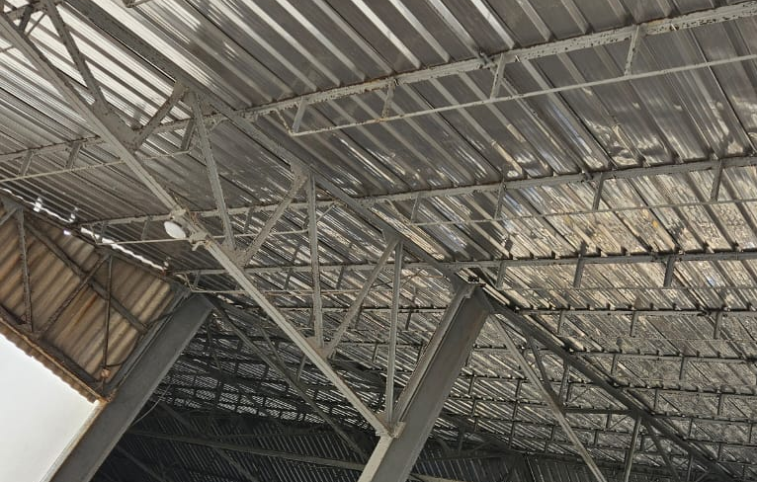
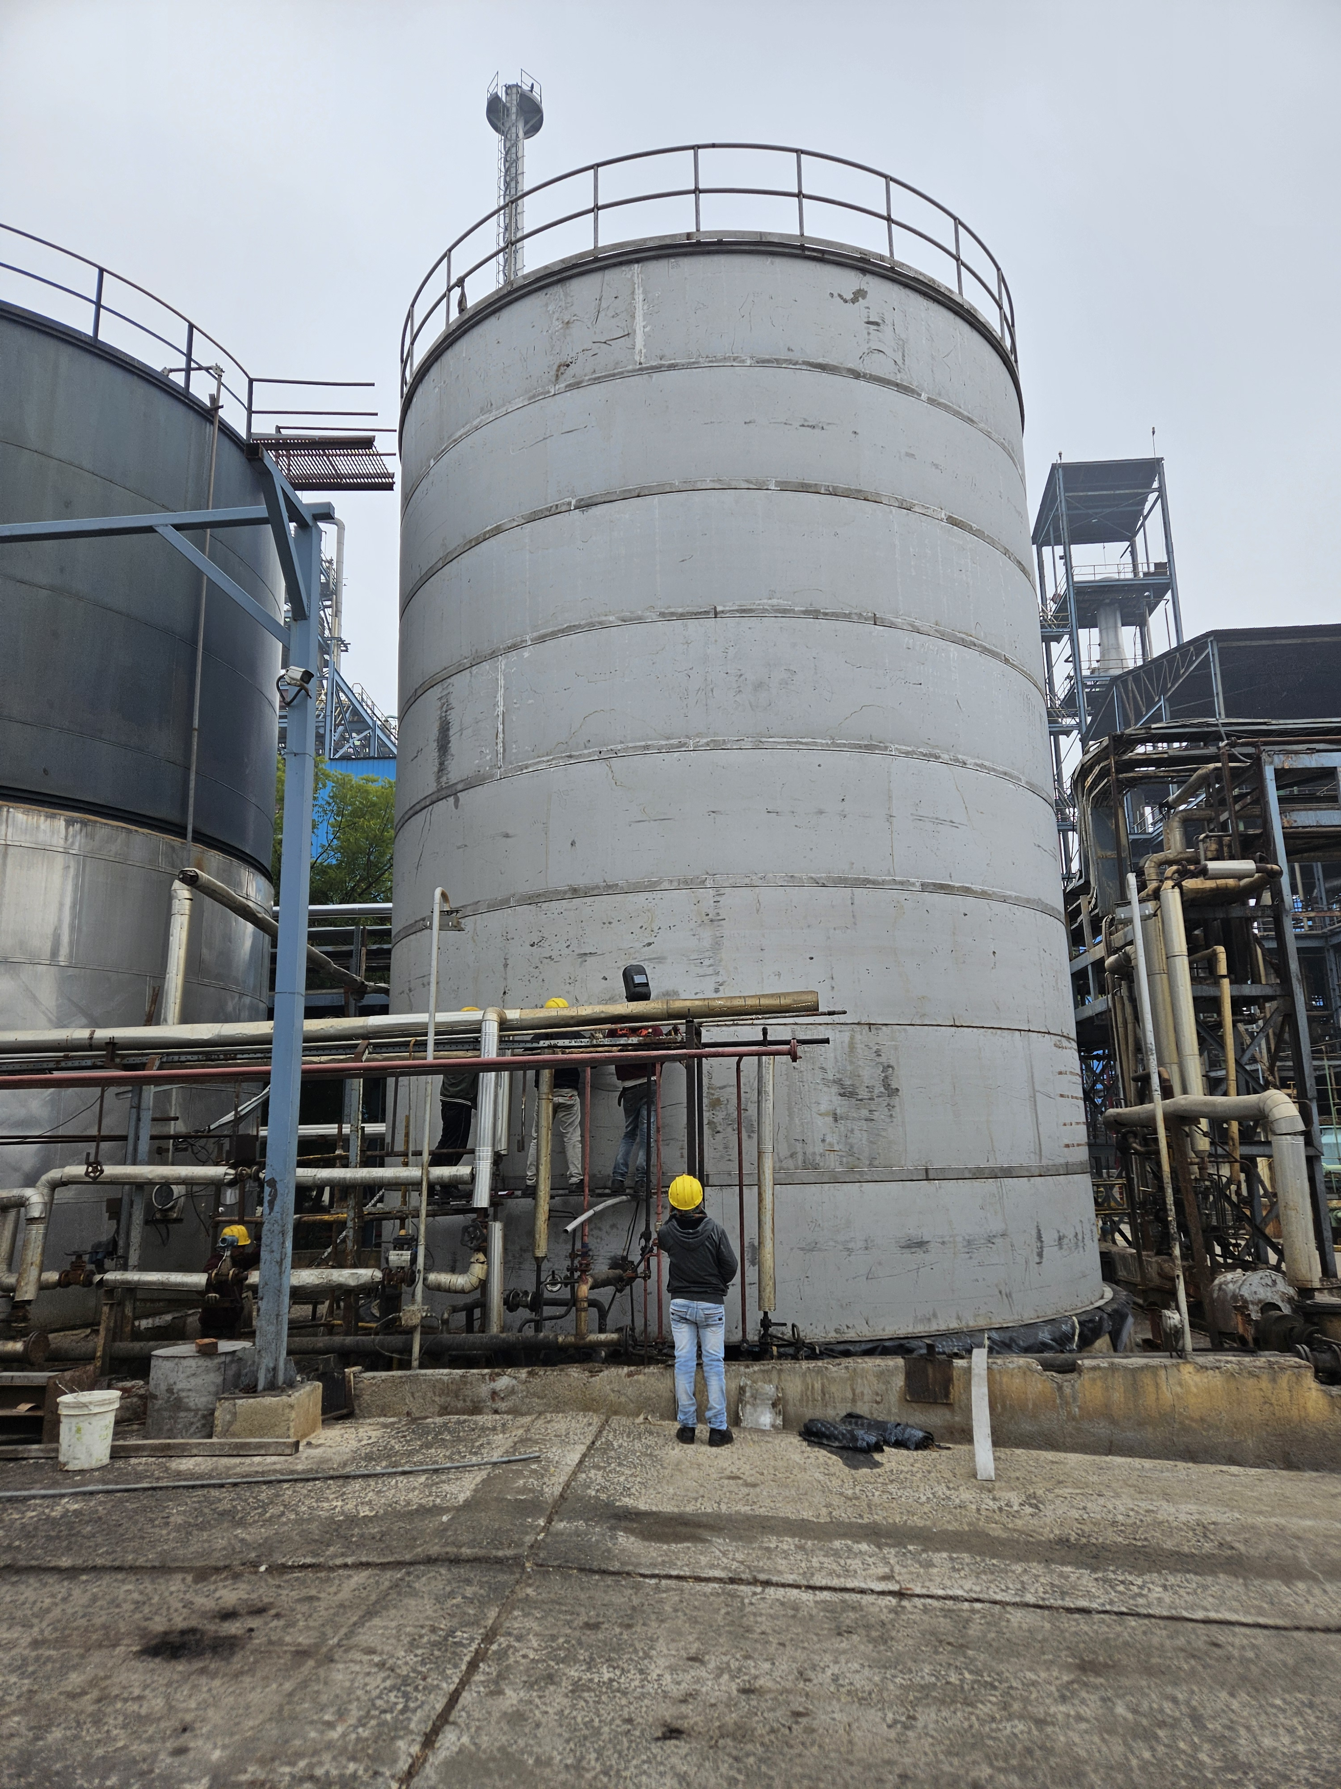
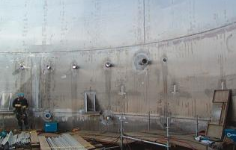

Actual Site Image – Fertilizer Storage Shed
Stainless Steel Storage Tanks
Smart Stainless Solutions for Cost Optimization in Chemical Plants
Flue Gas Desulfurization– Clad Plates
Engineered for Corrosion. Built for Performance.
Application-driven solutions backed by corrosion expertise, real plant references, lifecycle performance and advanced grade portfolio

Slide 2

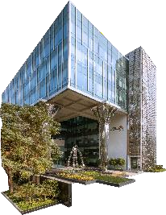
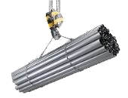

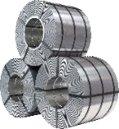
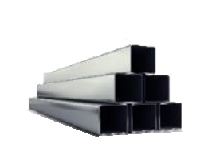
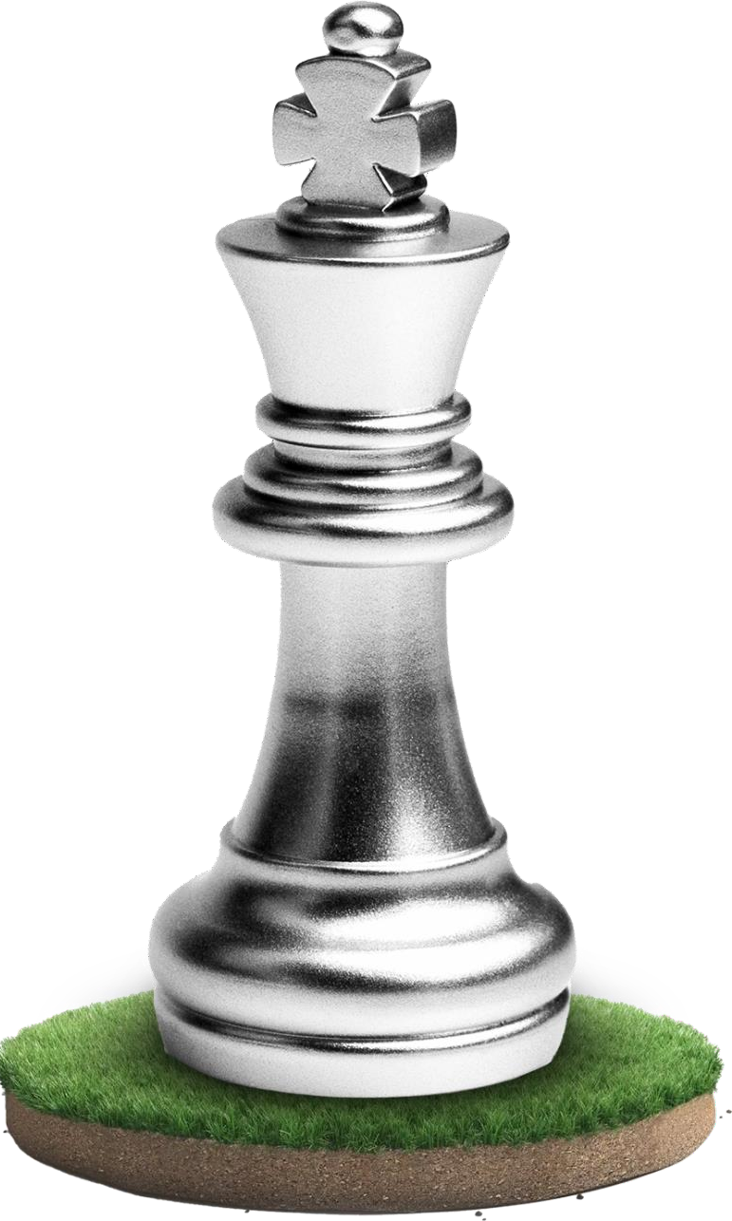
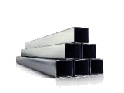








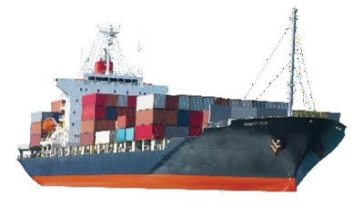


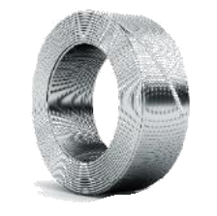
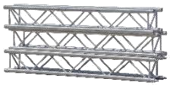



Jindal Stainless Leader in Specialized Products
#1
Stainless steel producer in India
#5
Top Global producer Ex - China
3mtpa
Stainless steel capacity
~₹ 429bn
Revenue (Net)*
~₹ 55bn
EBITDA*
0.2x
Net Debt/Equity*
50+
Exports to countries
>120 grades
Diversified High End
Product Mix
> 21,000
Manpower (incl. contractual)
*Standalone financials ending March 31, 2026
5

Slide 3
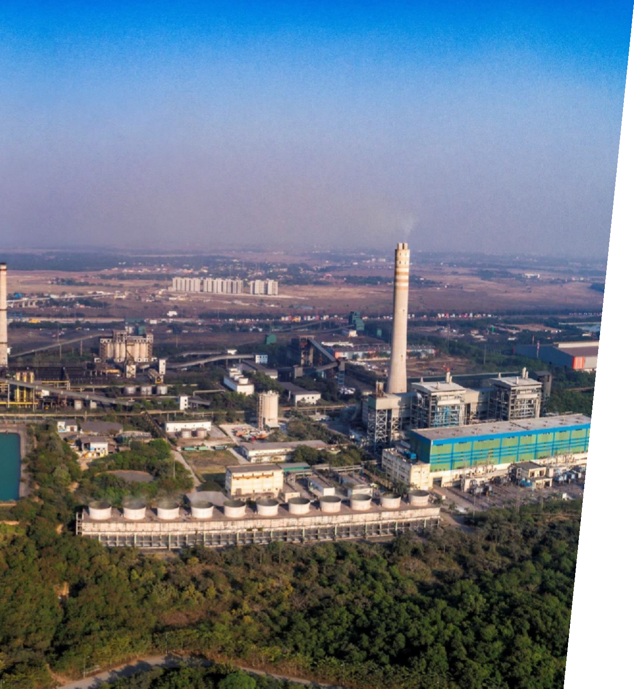
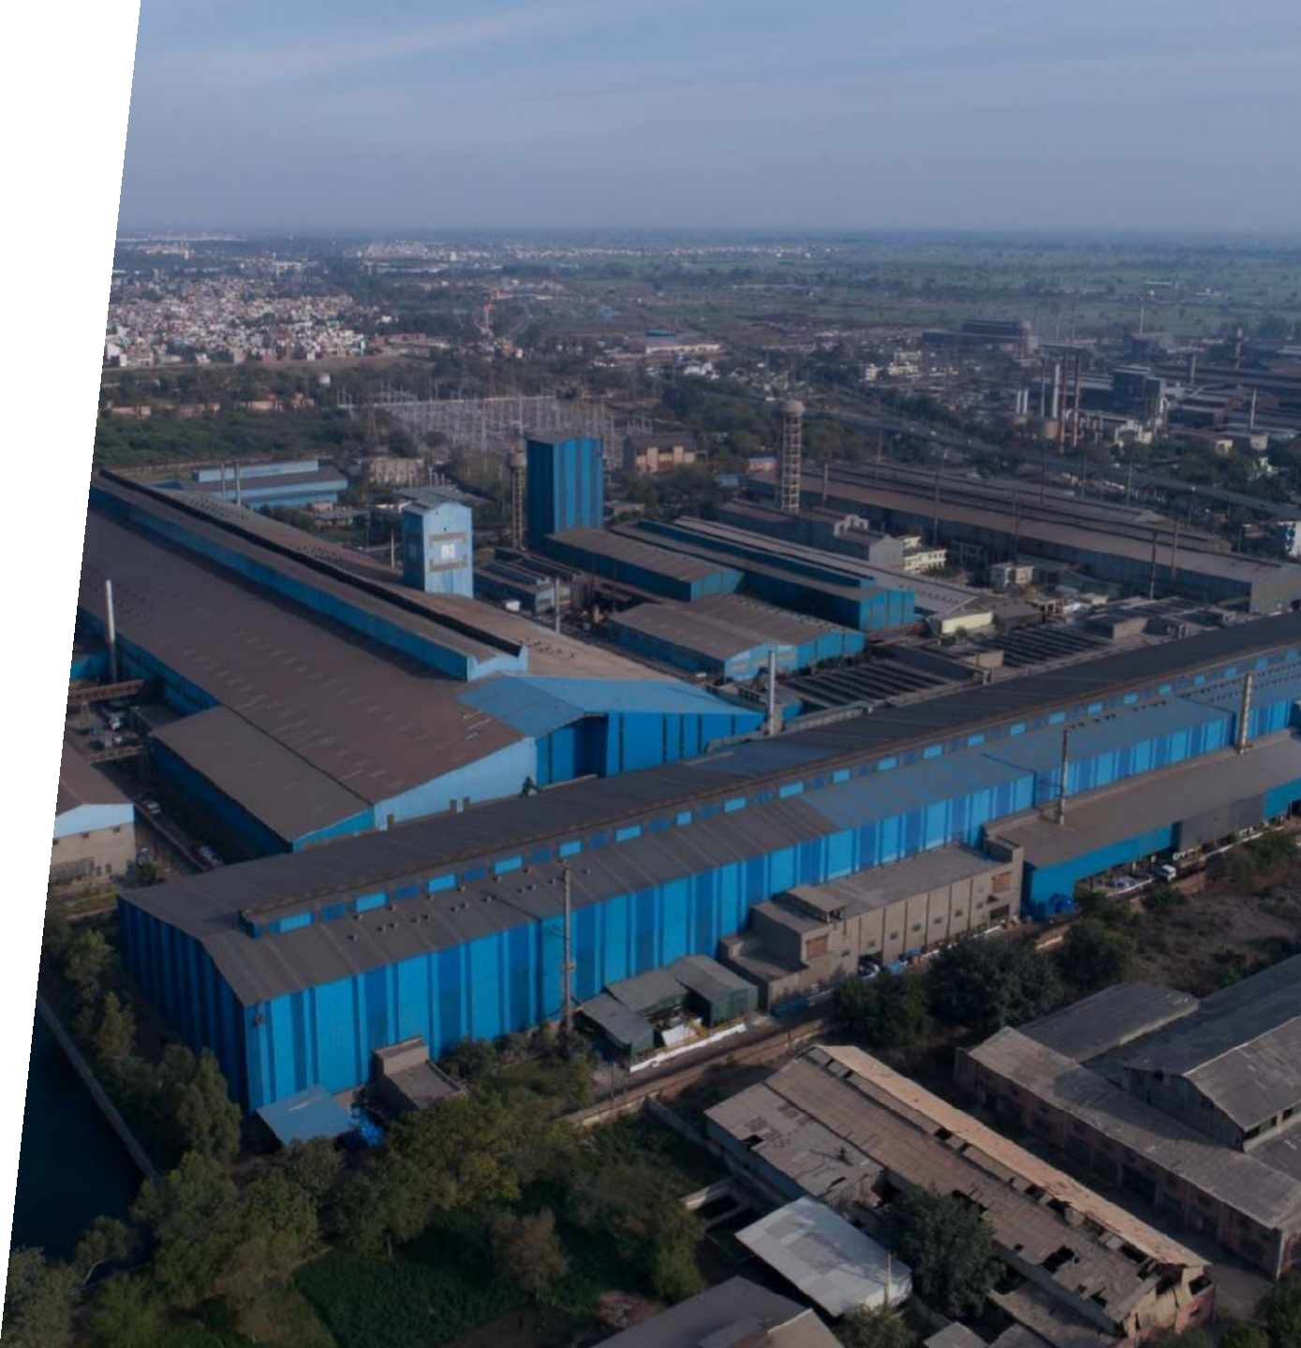












Ingenuity Meets Manufacturing Excellence
The heart of our operations
ODISHA
HISAR
Capacity – 2.2 MTPA
Capacity - 0.8 MTPA
Million Tonnes per Annum
7

Slide 4
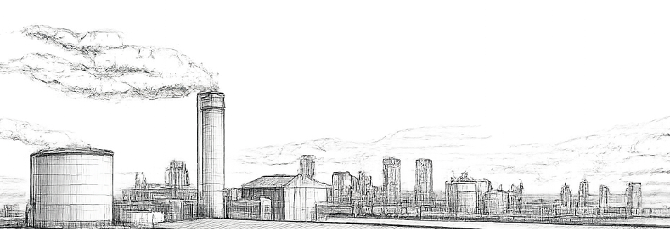
CONTENTS
01
Apart from Conventional Grades
04
Hot Rolled Bonded Plate
07
Case Study – Chequered Plates – SA Area
02
Recent High Performance Grades
05
08
Why Choose Jindal Stainless
JSL In Structural Components
Case Study – Roofing's – Fertiliser Plant
03
Case Study –Process/Storage Equipment's
06

Slide 5
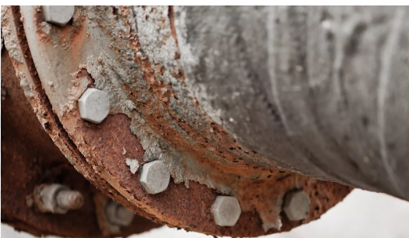
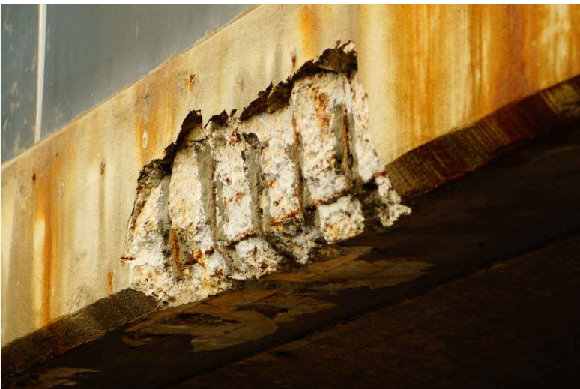
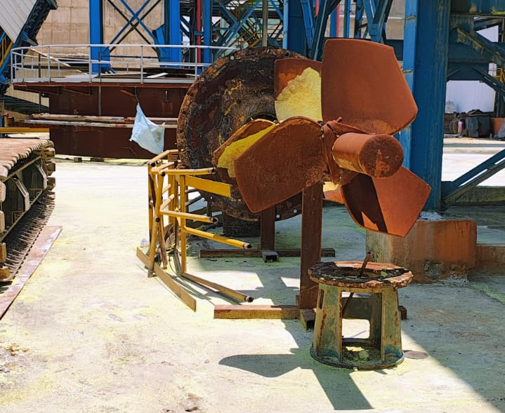
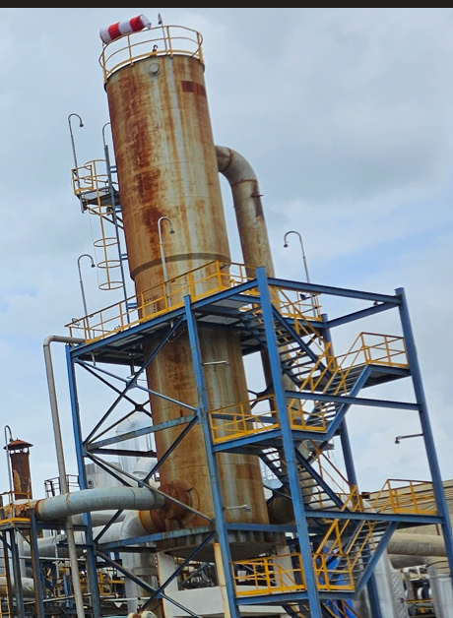
Chemical Industry Challenges
Corrosion — A Threat to Plant Reliability, Process Continuity & Safety
Process & Structural Challenges
Unplanned Plant Shutdowns
Premature Material Failure
Toxic Leakage & Safety Hazards
Plant Downtime – Structural Replacements
Frequent Maintenance, Repainting
Safety Risks in Elevated/Inaccessible Areas.
Typical Corrosion-Prone Areas
Acid handling zones
Walkways, gratings & platforms
Storage tanks & process vessels
Coastal / humid operating environments
Pipe racks & support structures
Crevice Corrosion
Concrete Spalling – Rebar Corrosion
Uniform Corrosion – Acid Impeller
Atmospheric Corrosion
Why Stainless Steel- Enhanced corrosion resistance with lower lifecycle, maintenance & improved reliability.
Notes:
Why Material Selection is Important
Corrosion Resistance
Mechanical Strength
Temperature Compatibility
Lifecycle Cost
Safety & Reliability
Maintenance Requirement
SA, Nitric Acid, PA, Acetylne Acid, HFL, etc
Corrosion is not just a material issue — it directly impacts safety, uptime, sustainability, and profitability

Slide 6
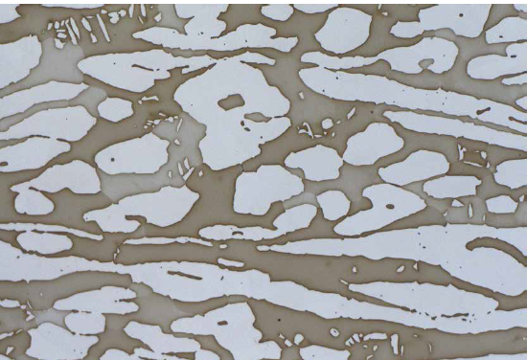
JSL SS Solutions for Process Equipment
Advanced Stainless Steel Grades Beyond Conventional 304/316
Conventional Grades
Austenitic – 304L, 316L (PREN >18, PREN>23)
Ferritic – 410s, 430 etc.
Duplex – Ferritic + Austenitic Phase
Lean Duplex – 2101, 2304 (PREN >26)
Duplex- 2205 (PREN > 34)
Super Duplex - S32750, S32760 (PREN > 40)
Super Austenitic Grades
316F (PREN >25)
317L, 317LN, 317LMN (PREN > 29)
904L (PREN > 34)
6Mo – UNS S31254 (PREN > 43)
309Si, 310s – High Temperature Application
Duplex vs Conventional SS304L/SS316L
~2× higher strength (450–550 MPa) → upto 30% weight saving
Higher PREN (~35–40) → better chloride resistance
Superior SCC resistance
Applications: Storage Tanks, process equipment, structures
Super Austenitic Grades vs Conventional SS304L/316L
High PREN (~34–43) → strong pitting resistance
Excellent acid resistance (phosphoric, sulphuric, nitric)
Better crevice corrosion resistance
Applications: Acid plants, storage, highly corrosive environments
Duplex microstructure showing darker etched ferritic regions and brighter austenitic regions
Notes:
PREN for 317LNM is 33

Slide 7
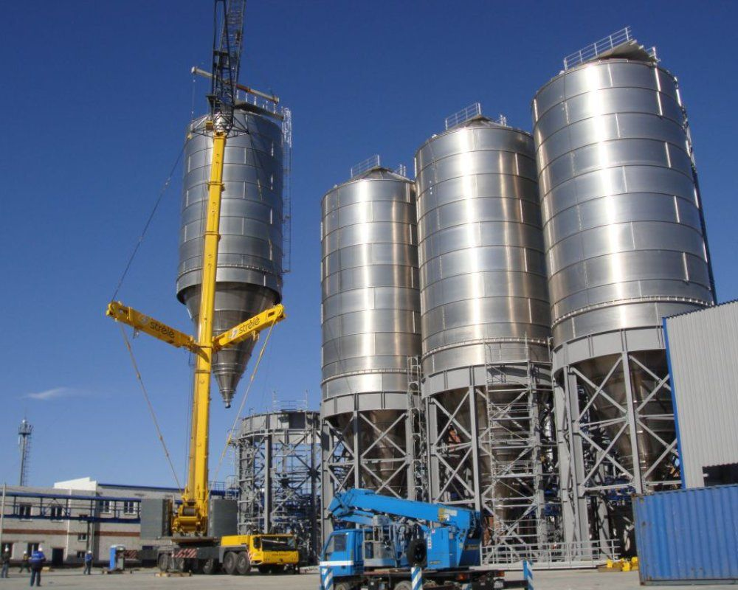
Case Study – Lean Duplex – UNS S32101
Strength Optimization for Large-Capacity PTA Silos
Application – PTA Storage Silo
Grade – Lean Duplex -2101
Challenge -
SS304L could not meet high-load strength and thickness requirements for large-capacity storage silos
JSL Solution:
Supplied 852 MT of LDSS 2101
Used in lower shell & cone lining for structural strength with thinner shell- Size - 21m (L) × 9.5m (D)
Impact
Optimized structural performance
Greater weight savings ~30%
Enhanced corrosion and mechanical resistance
* Representative Image Only
Notes:
Application: PTA Storage Silos (API 620 Standard)
Client: Indian Oil Corporation Ltd. (IOCL)
Contractor: Technip
Year?

Slide 8
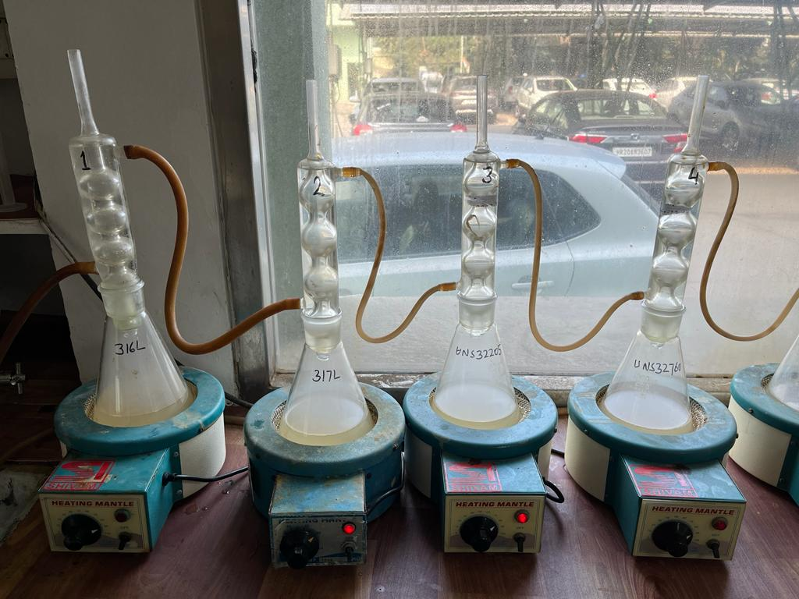
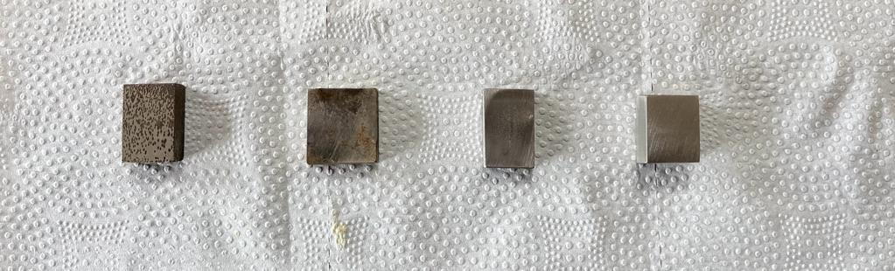
Case Study – Super Duplex – UNS S32760
Application-Driven Grade Selection with JSL
Application – Evaporator & Centrifuge Unit, ZLD System
Grade –Super Duplex -UNS S32750 / S32760
Challenge –
High Nickel-based alloys involved high cost and long lead times, while conventional grades exhibited corrosion under high-temperature effluent conditions
JSL Solution:
JSL R&D tested materials in real effluent at elevated temperature. Super Duplex outperformed alternatives in corrosion resistance
Impact
Replaced high value imports with indigenised Super Duplex SS
Faster project execution
Lower lifecycle cost as compared with conventional alloys
Chemical testing in alkaline water sample at 80 ° C
SS316L SS317L UNS S32205 UNS S32760
Grade | Initial Weight (gm) | Final Weight (gm) | Corrosion Rate, mpy
316L | 24.60985 | 24.56231 | 6.08
317L | 23.12367 | 23.11942 | 0.5
UNS S32205 | 18.48601 | 18.48489 | 0.16
UNS S32760 | 26.74936 | 26.74911 | 0.03

Slide 9
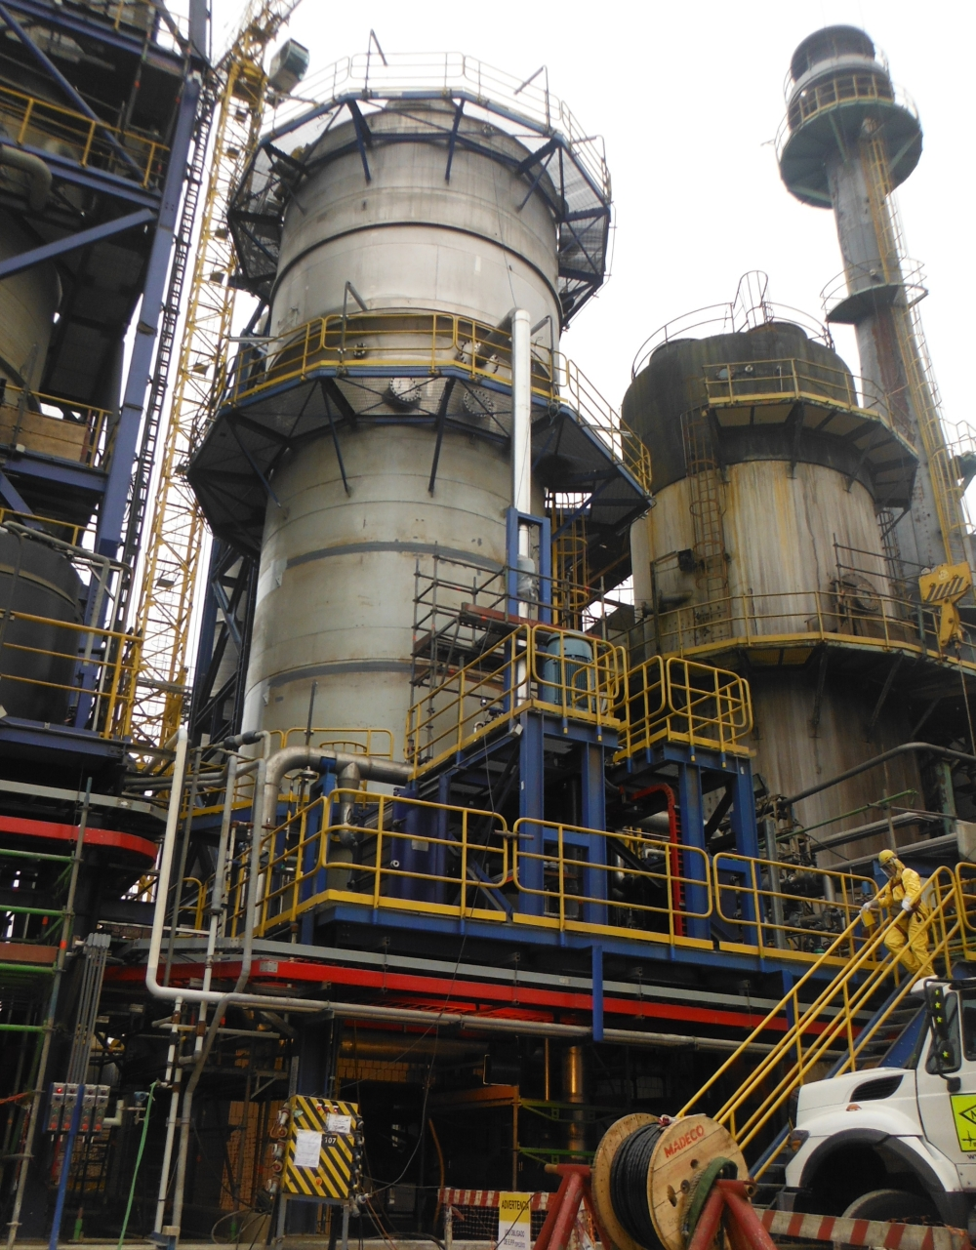
JSL Advancing India’s Self-Reliance
Expanded High-Performance Grade Portfolio
EQ Grades (EQ309LMo, EQ316L, EQ309LNb, EQ309L, EQ24.13LNb)
Clad Strips , Weld Overlay Clads
S30815
High Temperature Performance, Furnace, Kilns
EN 1.4547/UNS S31254 – PREN>42
Heat Exchanges, Acid/Chloride Services
316F
High Machinable Grade
EN1.4841/314
Super Heater Tubes
UNS S32615 - 5% Si Grade
Sulphuric Acid, Nitric Acid Absorption Tower
304L-NAG
Nitric Acid Handling
Alloy Steel – 9Cr1Mo
UNS S32615 –Performance for SA Absorption Towers
Corrosion rates in absorption tower environment with 99% Sulphuric acid at 105-115 °C
Alloy | Corrosion Rate
 | mm/y | mpy
304 | 0.02 | 0.8
316 | 0.06 | 2.2
5% Si | 0.005 | 0.2
904L | 0.17 | 6.8
20Cb-3 | 0.08 | 3.2
C-276 | 0.32 | 12.6
B-2 | 2.3 | 91
Notes:
Atmanirbhar Bharat Pitch
Alloy 20- (35Ni-20Cr-3.5Cu-2.5Mo)

Slide 10
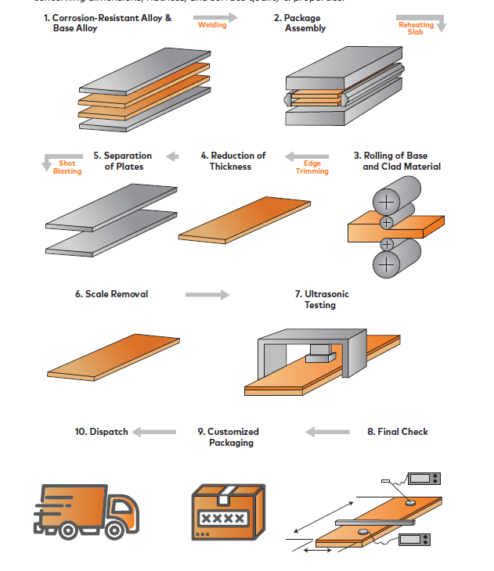
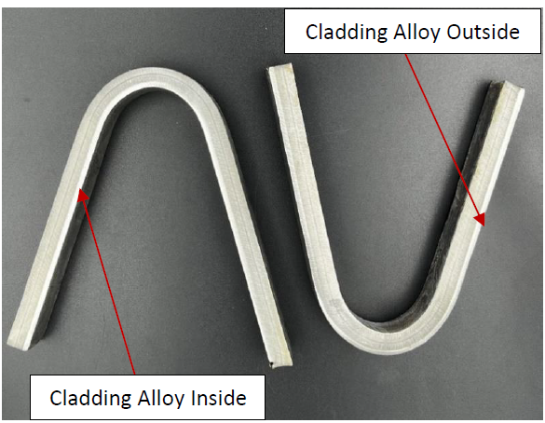
JSL - Innovation – Hot Roll Bonded Plates
Advanced Clad Solutions - Corrosion Resistance with Structural Strength
Hot Rolled Clad Plates - Innovative composite materials consisting of two metallurgically bonded layers.
A thin layer of Corrosion Protection Alloy
Base of High Strength Steel – Cost Effective + High Strength
The metallurgical bond is formed in a meticulously controlled hot-rolling process, ensuring superior quality and durability
C276 + IS 2062 E250
Notes:
Base Layer - ensuring high strength and toughness

Slide 11
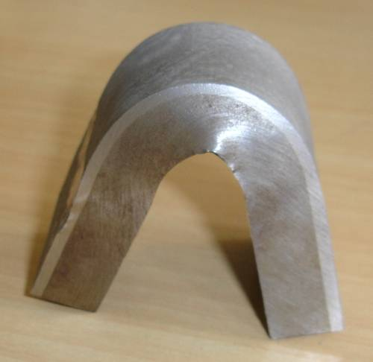
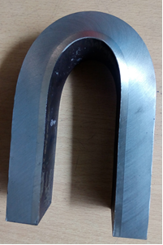
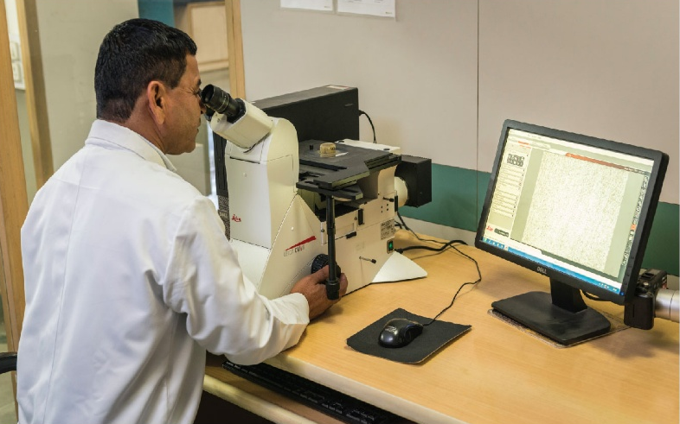
JSL - Innovation – Hot Roll Bonded Plates
Engineered Clad Solutions for Process Industries
Backing Steel | Cladding Alloys
A285 gr A, B, C, | 405, 410S, 430
A516 gr 55, 60, 65, 70 | 304, 304L
A204 gr A, B, C, | 309S, 310S
A387 gr 11, 12, 22, | 316, 316L, 317L
A 537 Cl2, A533 gr C, A533 gr B | 321, 347
API 5L X-42/X-46/X-52/X-56/X-60/X-65/X-70 | 625, C-276, 825
Thickness (mm) | Width (mm) | Length (mm)
8.0-20.0 | 1000-1200 | Up to 8000
Testing & Inspection Ensuring Durability & Quality
Ultrasonic Test | IASTM A578 Level C, S7 (ASTM A265 Quality Level : Class 1)
Visual & Dimensional Inspection, Surface finish, % Edge Condition | Checked dimensions, surface finish, edge condition, flatness, etc.
Mechanical Properties Bend and Hardness Test | As per ASTM A265
Shear Test | As per ASTM A265
Corrosion Test | As per specifications ASTM A262
Notes:
Mechanical Properties - UTS, YS, % Elongation
Comments - Any other type of testing as desired by the customer can be carried out based on mutual agreement

Slide 12
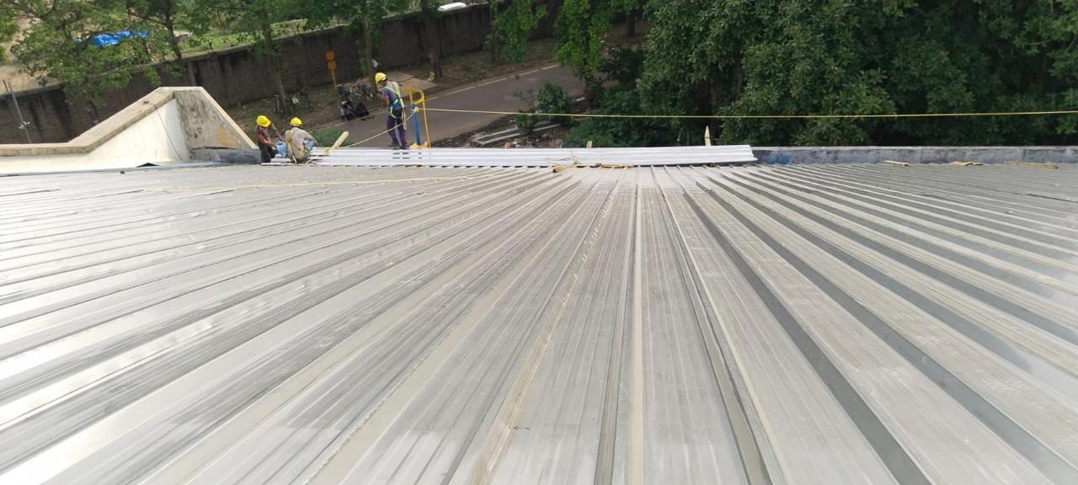
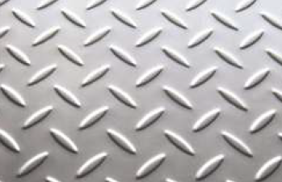
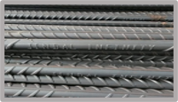
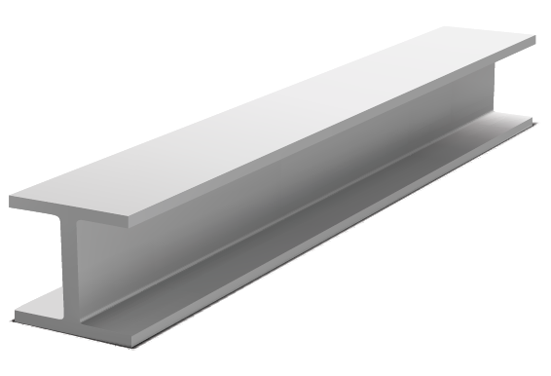
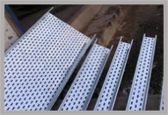
JSL - In Structural Components
Ferritic – Used for: Angles, Channels, Beams, Chequered Plates (Walkways)
409M – Ferritic + Martensitic Structural, good strength + cost-effective corrosion resistance
410S – Higher strength, great alternate to Standard Steel Rebars
430 -
441 - For Mild-Industrial/Sub Coastal
Austenitic – Chequered Plates/Roofing's – (High Corrosion Resistance)
304 - Industrial/Chemical Environment
316 – Coastal + Aggressive Chemical Environment
Lean Duplex – Structural Components in aggressive environments
2101 – High strength, cost-effective duplex alternative
2304 – High Strength & better performance
Roofing’s
Chequered Plates
Rebars
Angles, Channels
Cable Trays

Slide 13
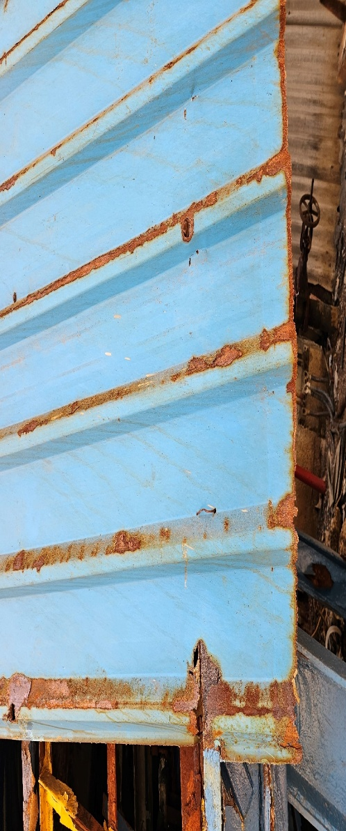
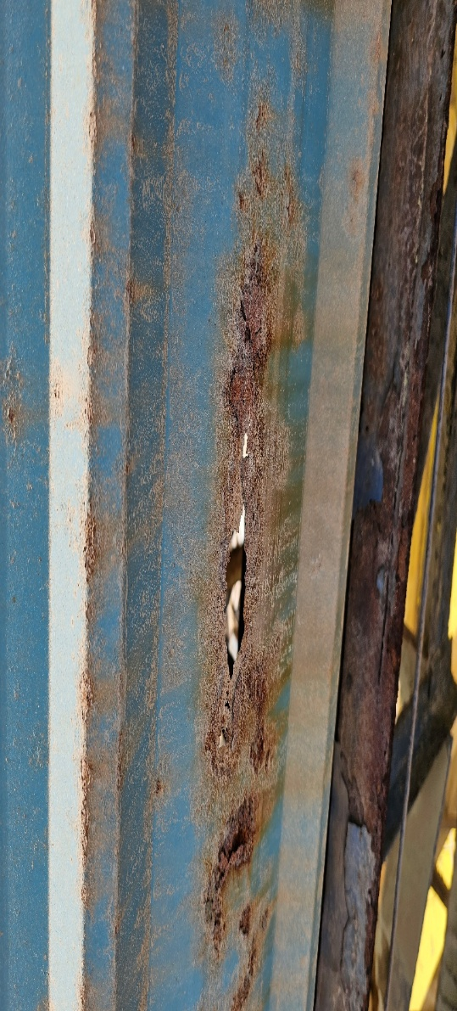
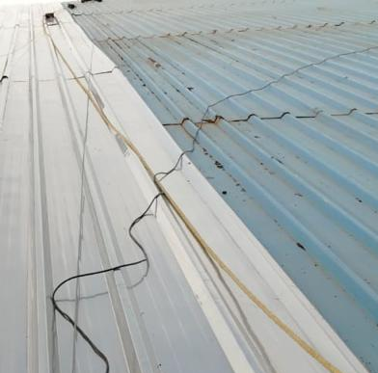
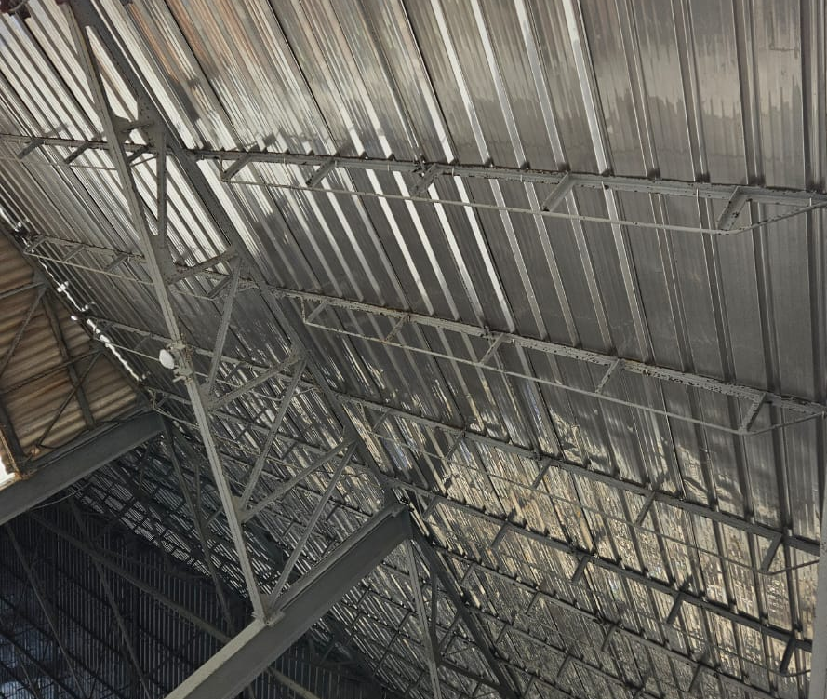
Case Study – Stainless Steel in Roofing's
Long-Life Stainless Steel Roofing for Corrosive Fertilizer Units
Challenge :
Sulphuric acid mist + phosphoric vapours
Fluorides & chlorides → pitting corrosion
Hygroscopic fertilizer dust → retains moisture
Leakage issues affecting storage safety
High downtime + maintenance burden
Structural risks due to corrosion
JSL Solution :
SS 304 Stainless Steel Roofing, 0.5mm
Excellent resistance to: Acidic fumes, Fertilizer chemicals, Moisture + salt deposits
No coating → no failure risk
Reflects solar radiation → lower heat inside plant
Maintenance- Minimal
Higher Safety and Reliability
GI Sheets – Corrosion issues within 18-24 Months
Current Site Images

Slide 14
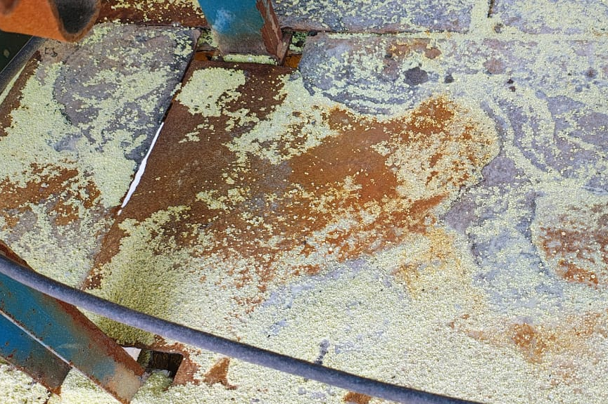
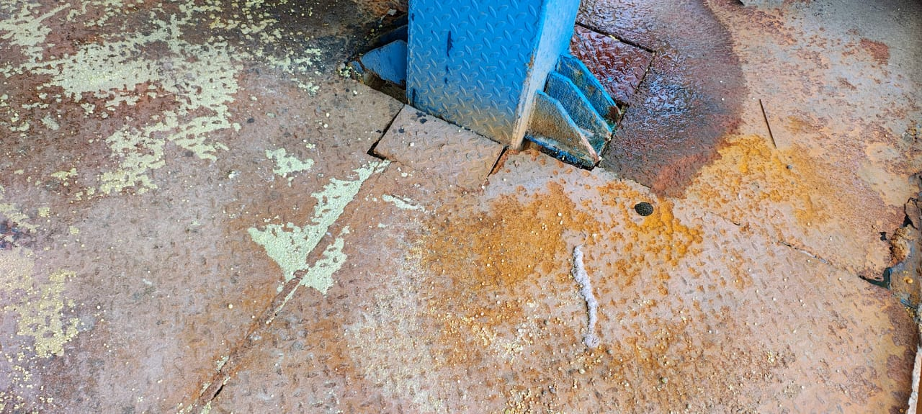
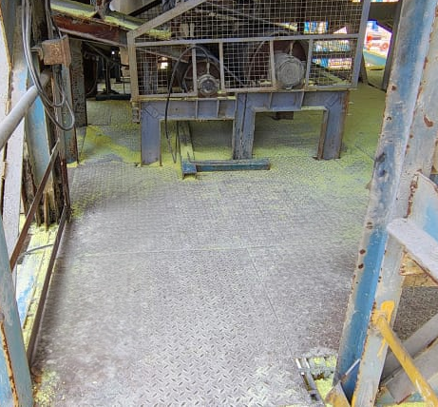
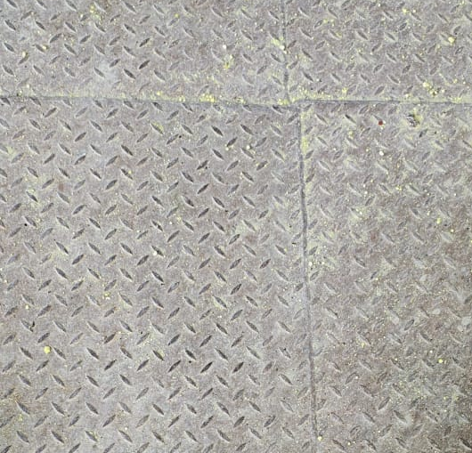
Case Study – Stainless Steel Chequered Plates
Corrosion-Resistant Flooring for High-Corrosion Applications
Challenge :
Severe corrosion of MS chequered plates in sulphuric acid plant environment
Acidic fumes and sulphur-bearing deposits accelerated plate deterioration
Frequent replacement leading to high maintenance and downtime
Corrosion-induced safety risks in operating walkways and platform areas
JSL Solution :
SS 409M Stainless Steel chequered Plates
Improved resistance to sulphuric acid fumes, moisture and chemical deposits
Cost effective with extended service life
Reduced Maintenance
Improved - Safety and Reliability
MS Chequered Sheets – Corrosion issues within 18 Months
Actual Site Images –post change to 409M

Slide 15






Why Choose Jindal Stainless
Proven in real plants
Assurance
Multiple Grades & Sizes
120+ Grades
Backed by R&D grade expertise
Built for tough environment
BUILT TO LAST
BUILT TO PERFORM

Slide 16
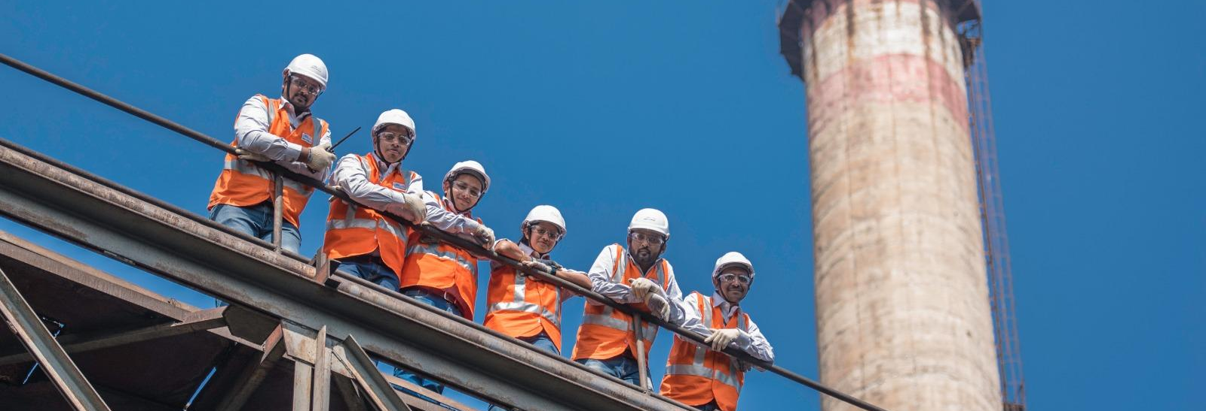
FOR ENQUIRIES / DISCUSSIONS
Meet us at Stall 17
or
Drop an email at mayank.agarwal@jindalstainless.com
salesdevprocess@jindalstainless.com

Slide 17
